Slide 1
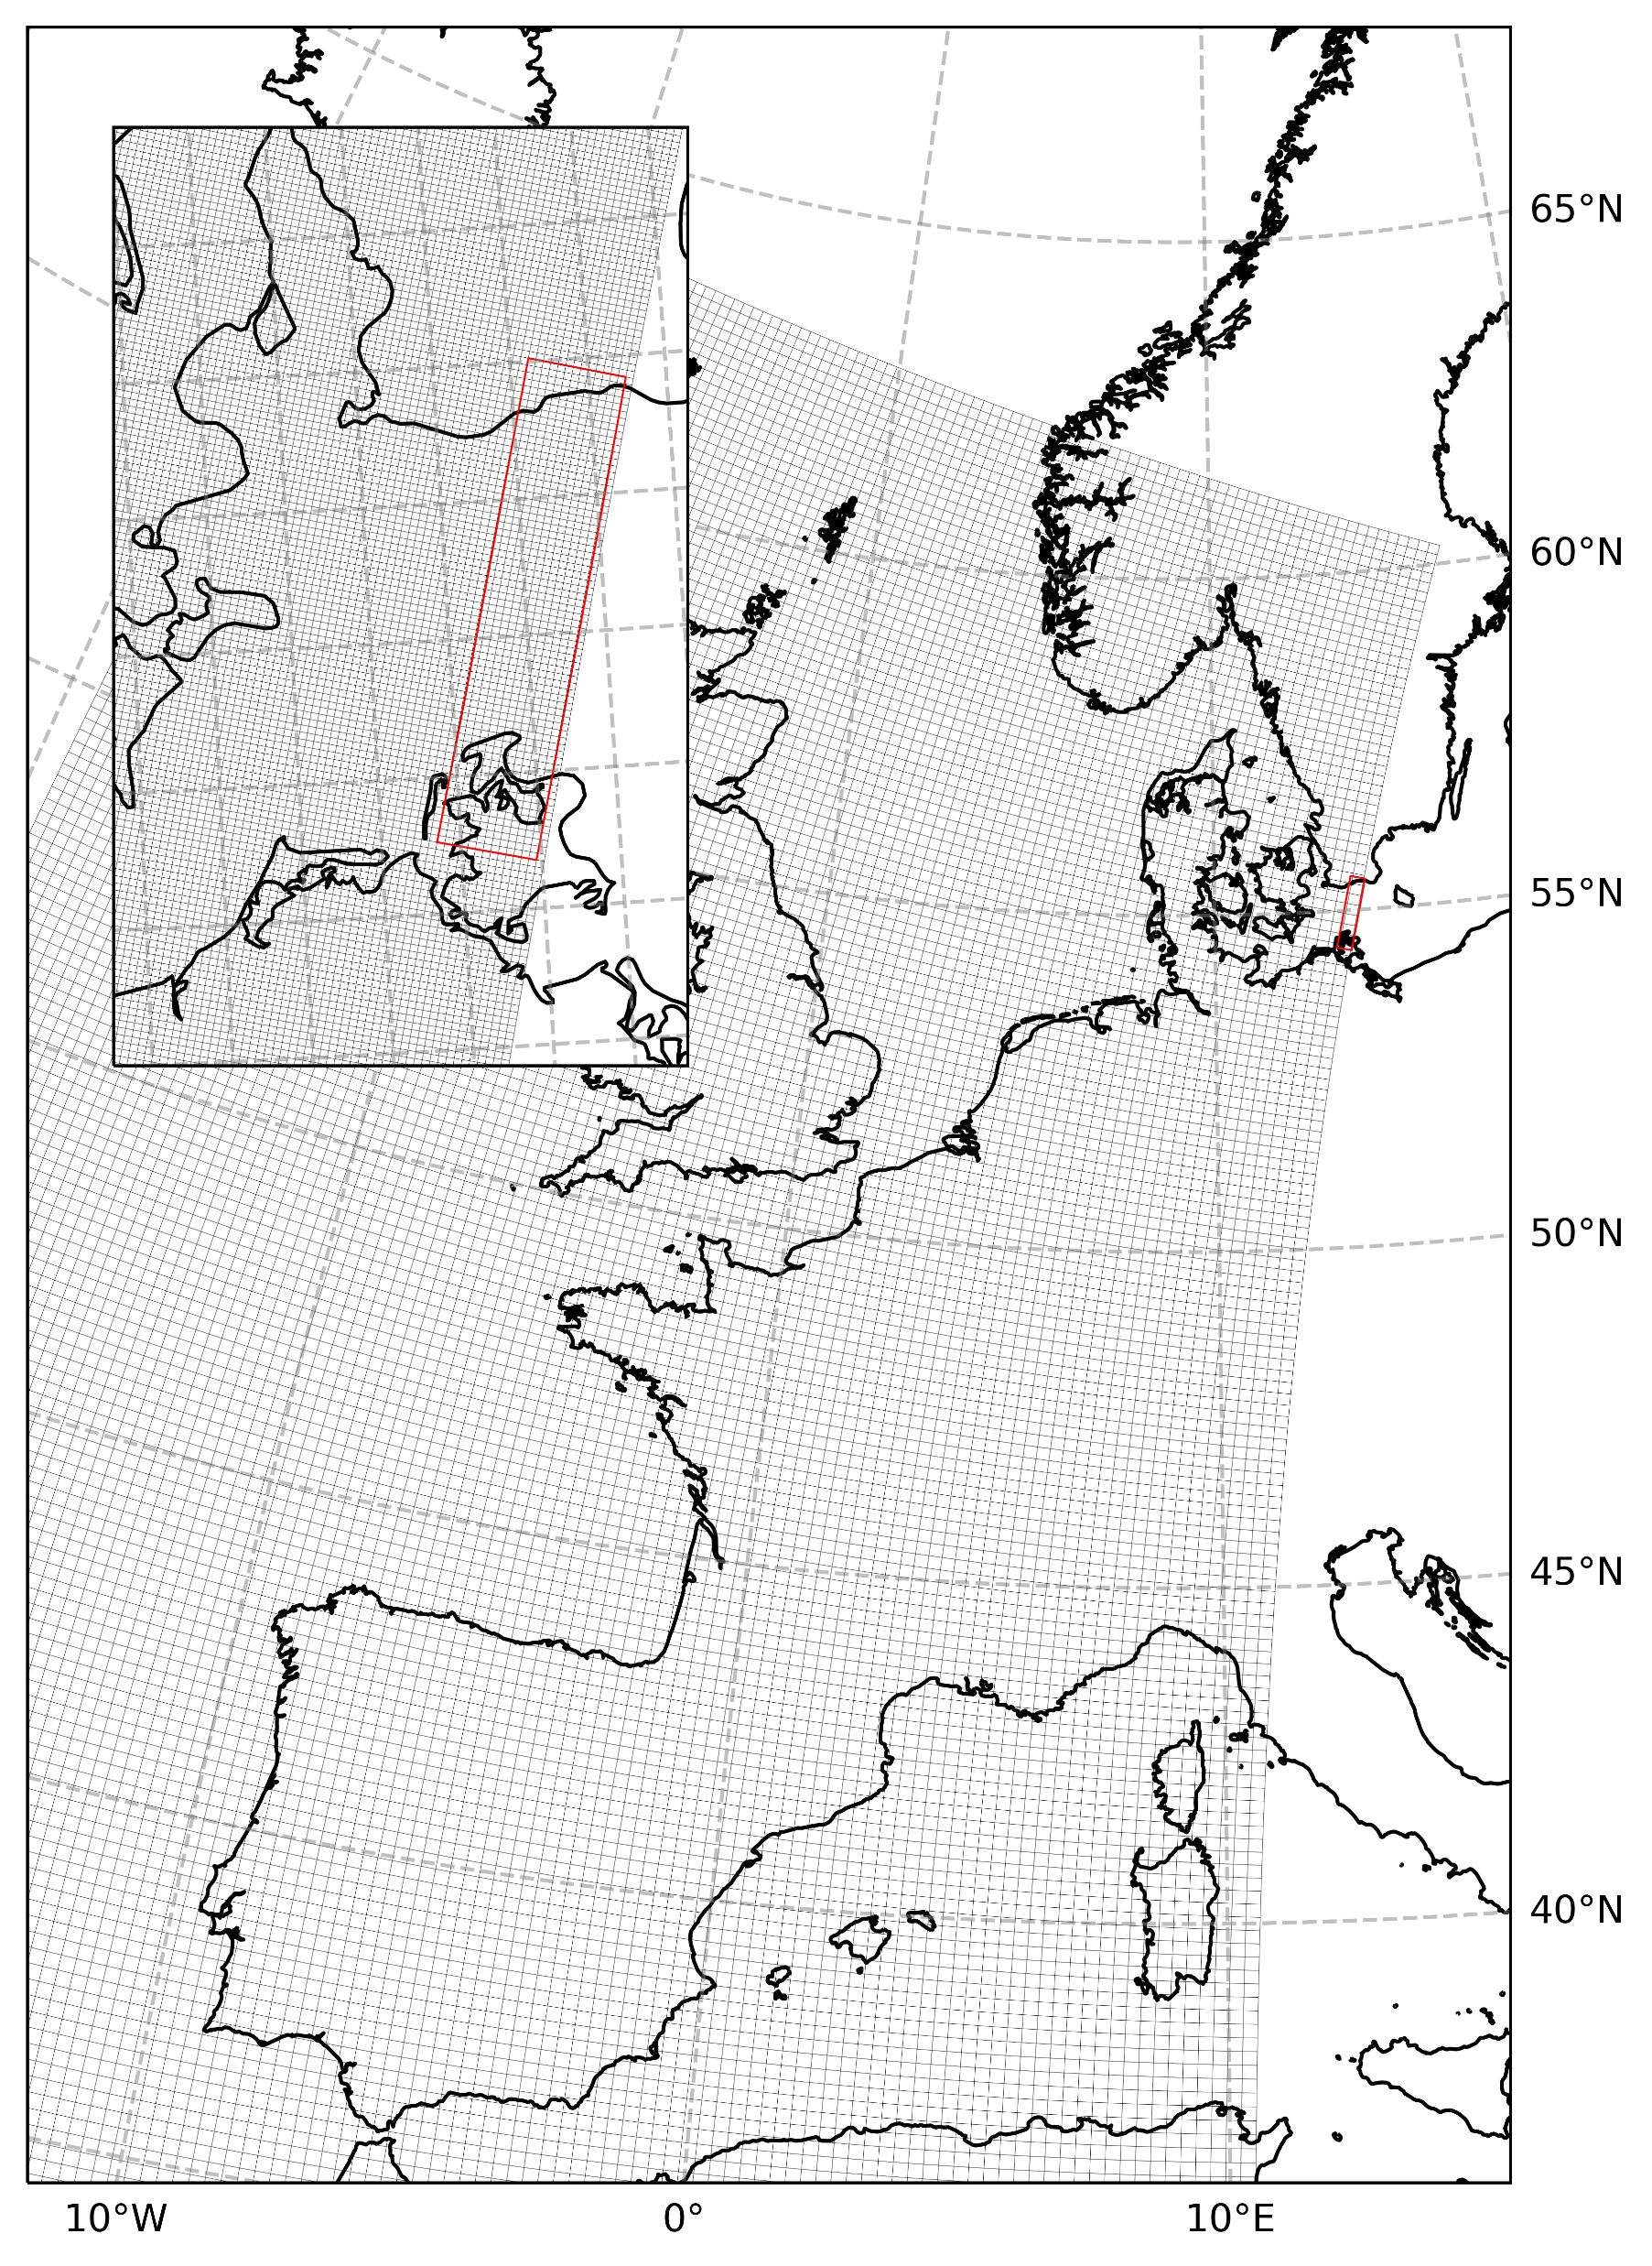
CMEMS Baltic LBC For NEATL36 Configuration

Slide 2
Summary

Slide 3
Context

Slide 4
Creation of LBC Files

Slide 5
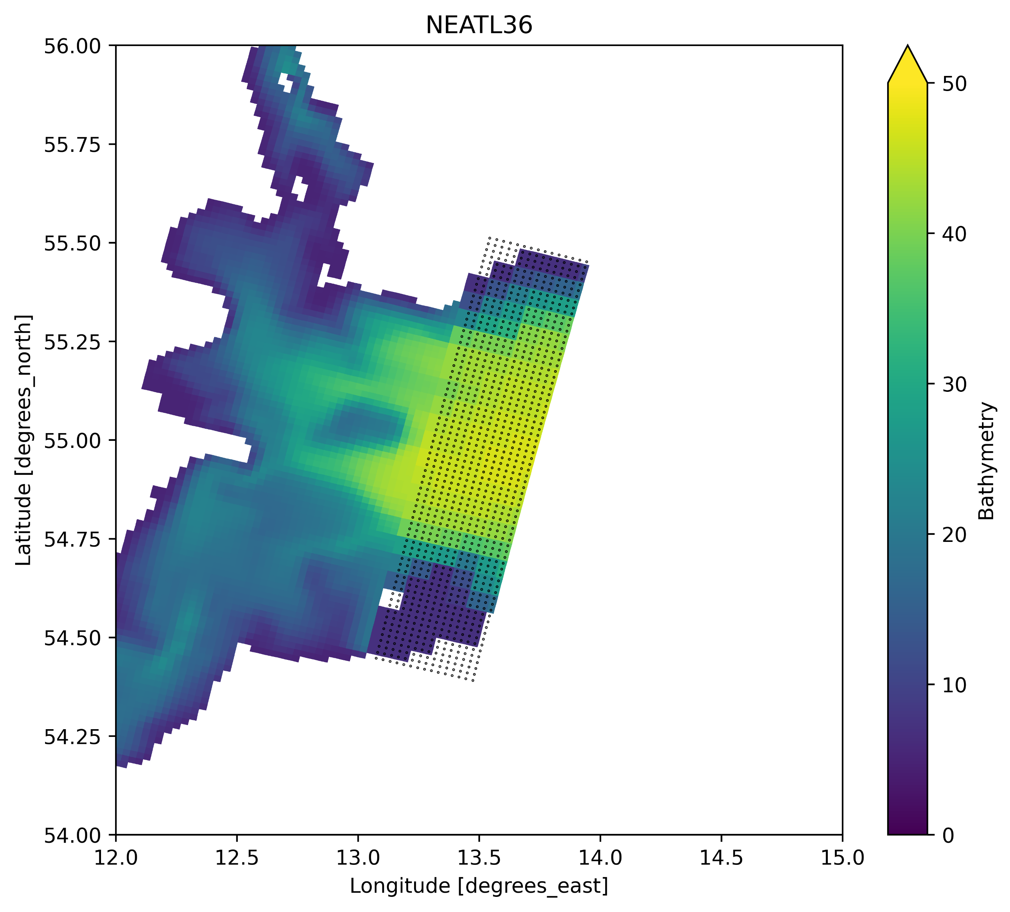
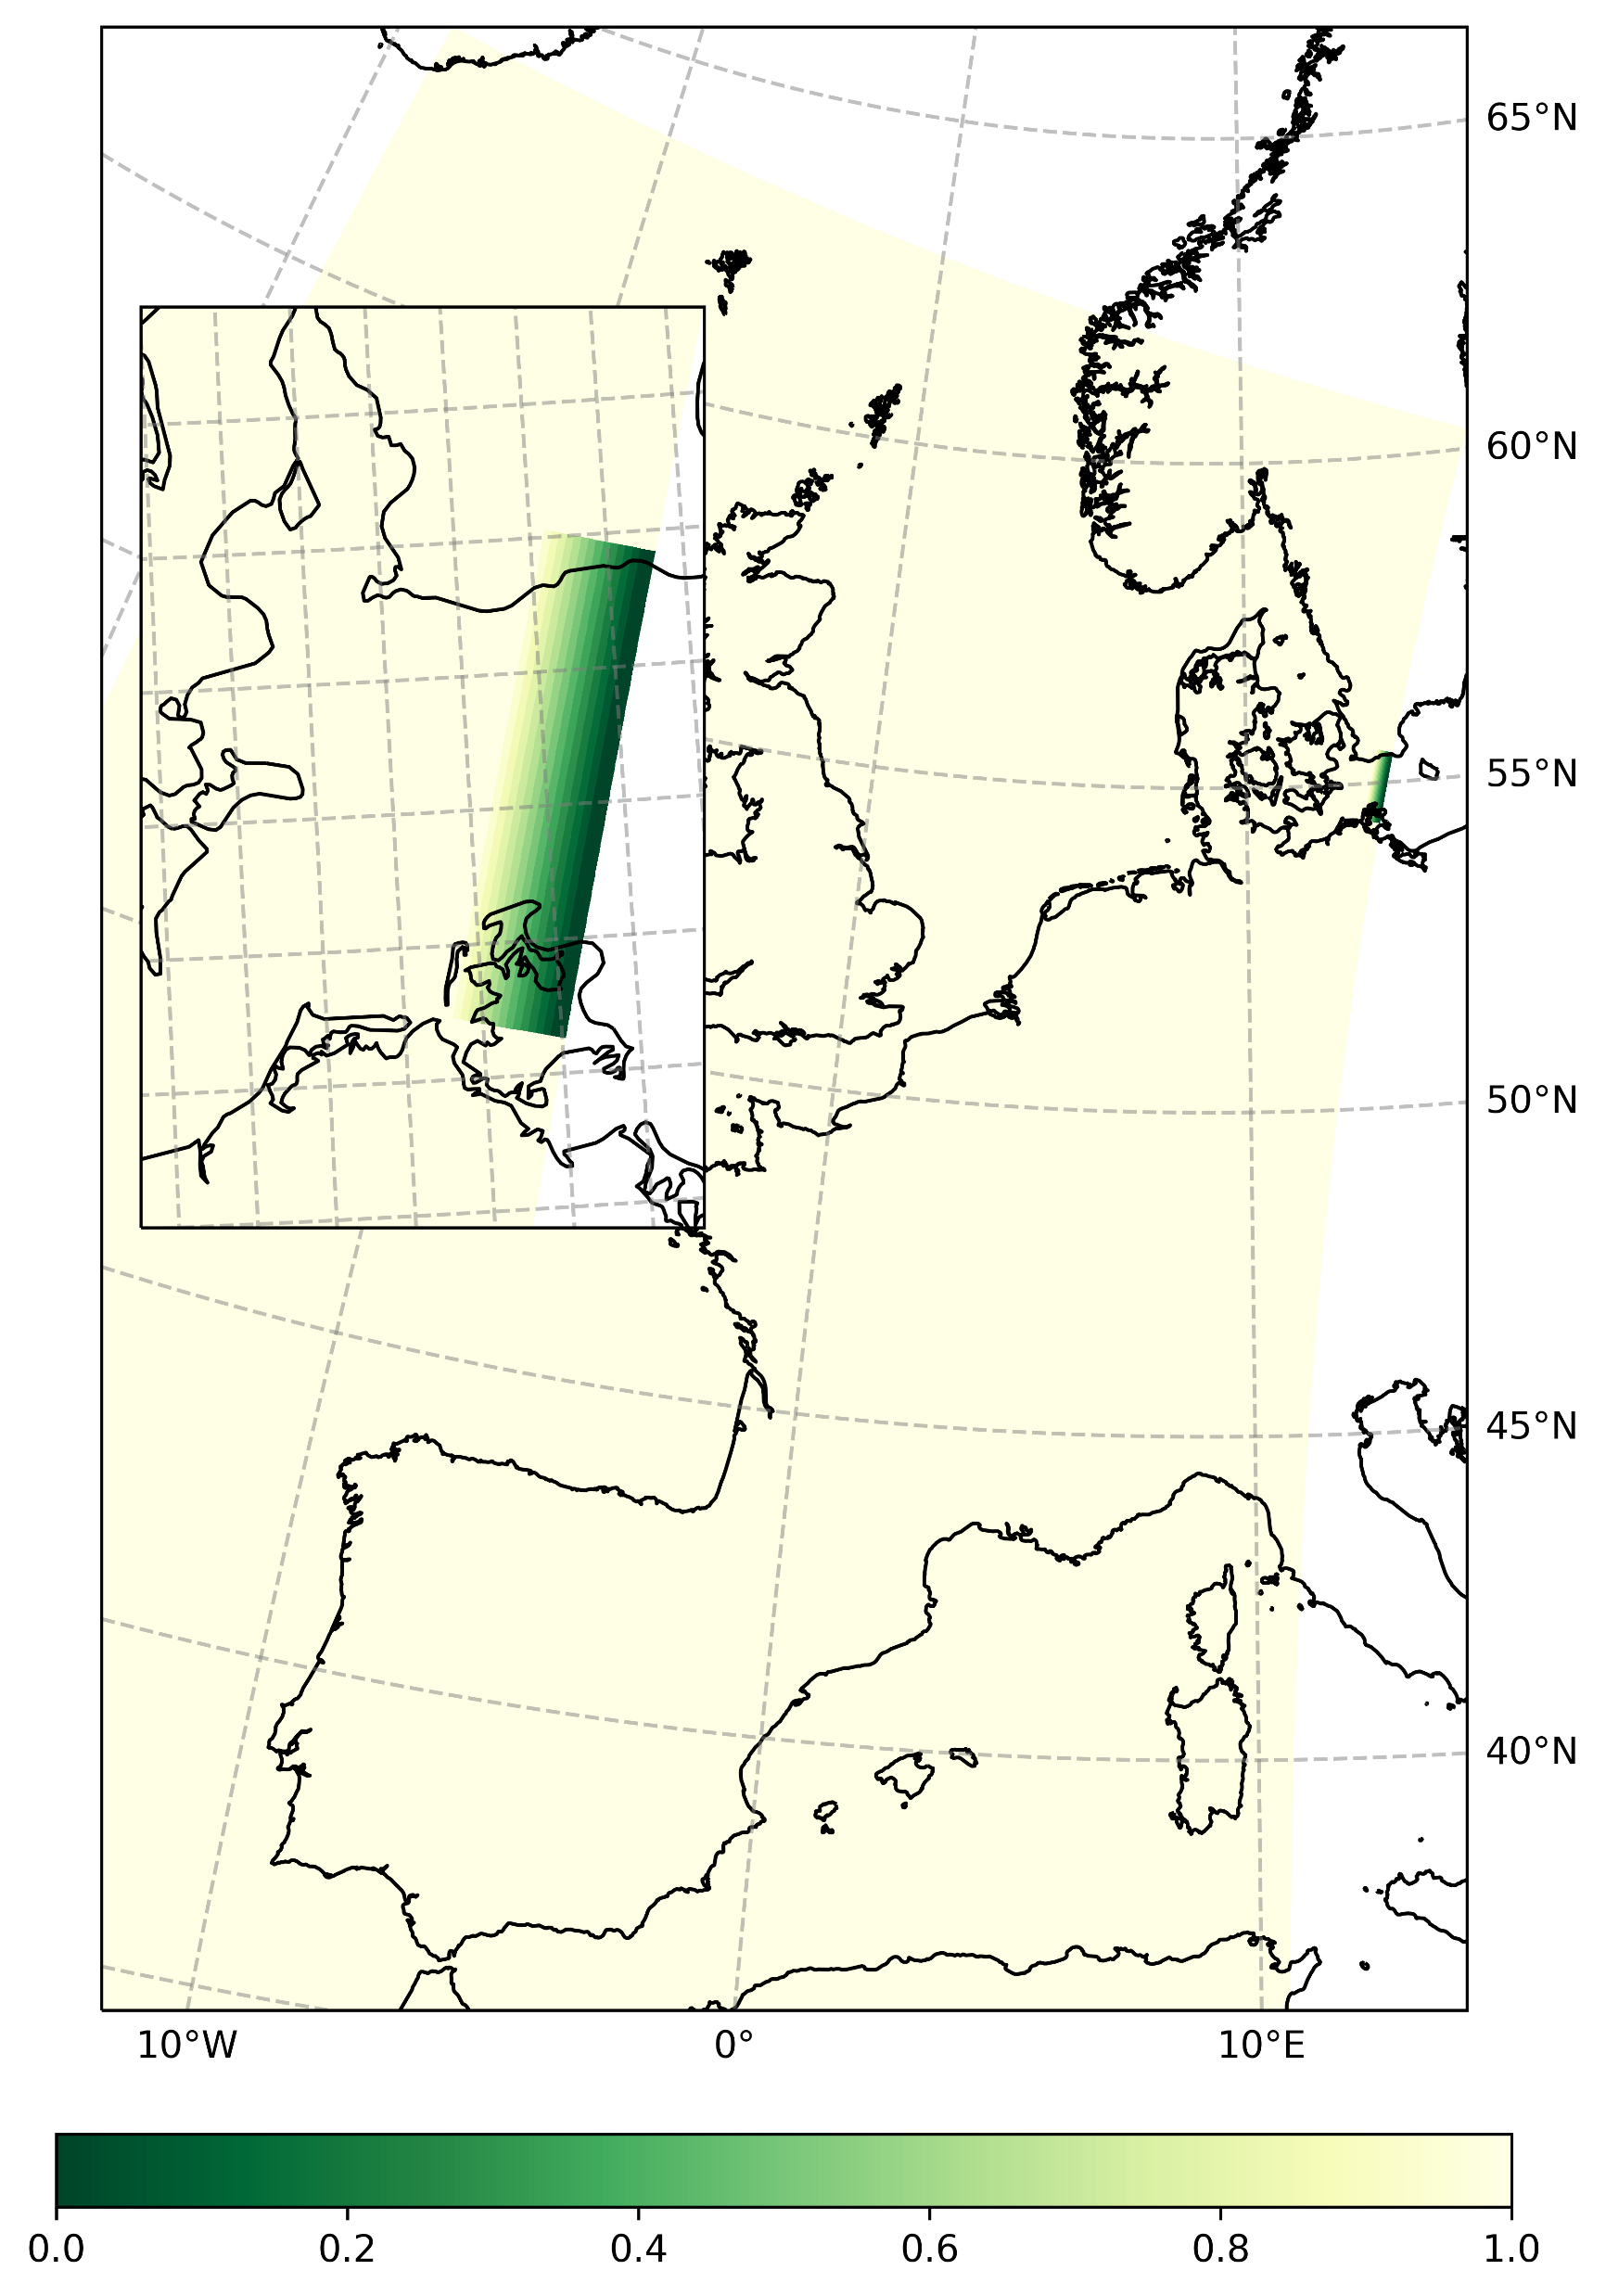
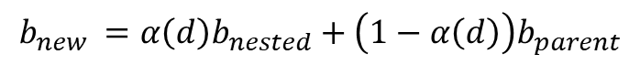
Bathymetry Relaxation
Open boundary puts into communication models with different configuration, resulting into a discontinuity at any rate.
GEBCO bathymetry information is used in both NEATL36 and BALMFC configurations that operate on different meshes though.
In the case IBI (nested in GLO12), the bathymetry of the relaxation areas of open boundaries is clamped to the parent model (fig up-right).
To make the NEATL36 – BALMFC smooth the bathymetry can be relaxed to parent model with a linear function
$$b_{new }=α\left(d\right)b_{nested}+\left(1−α\left(d\right)\right)b_{parent}$$
Where d is the distance from the boundary and alpha is a linear function of d (fig. down-right)

Slide 6
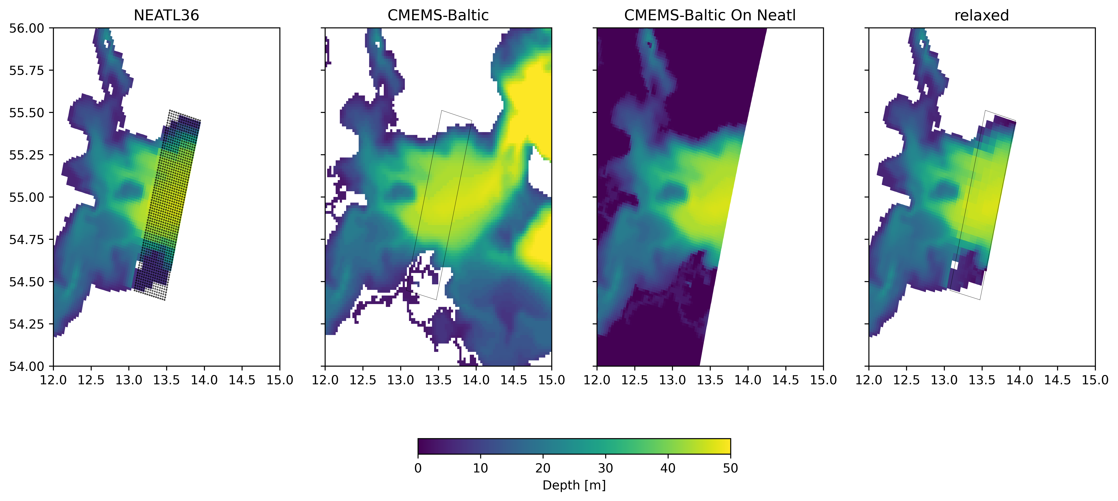
Bathymetry Relaxation
T-mask is preserved

Slide 7
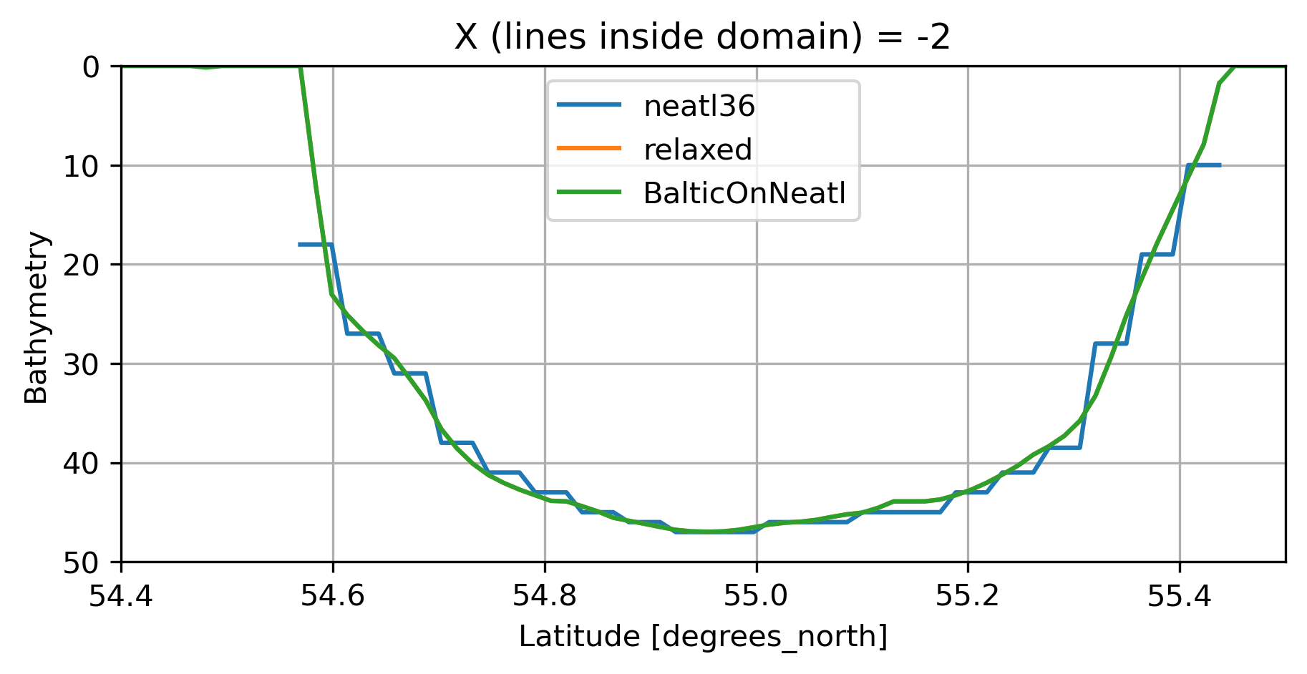
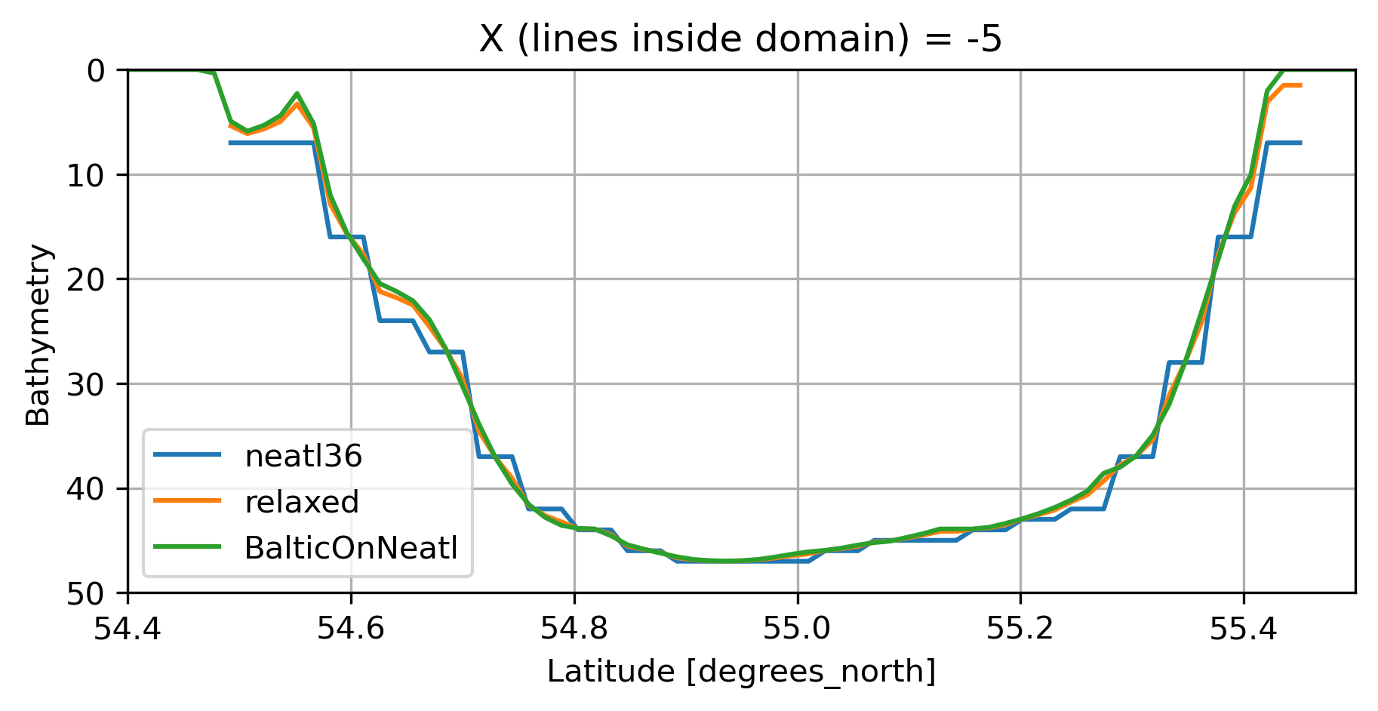
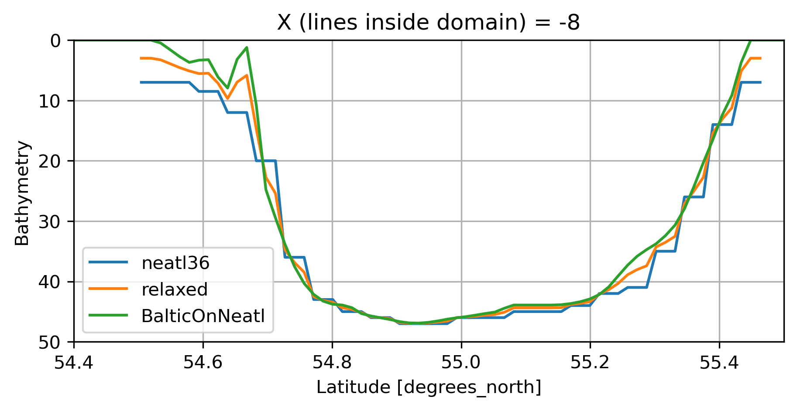
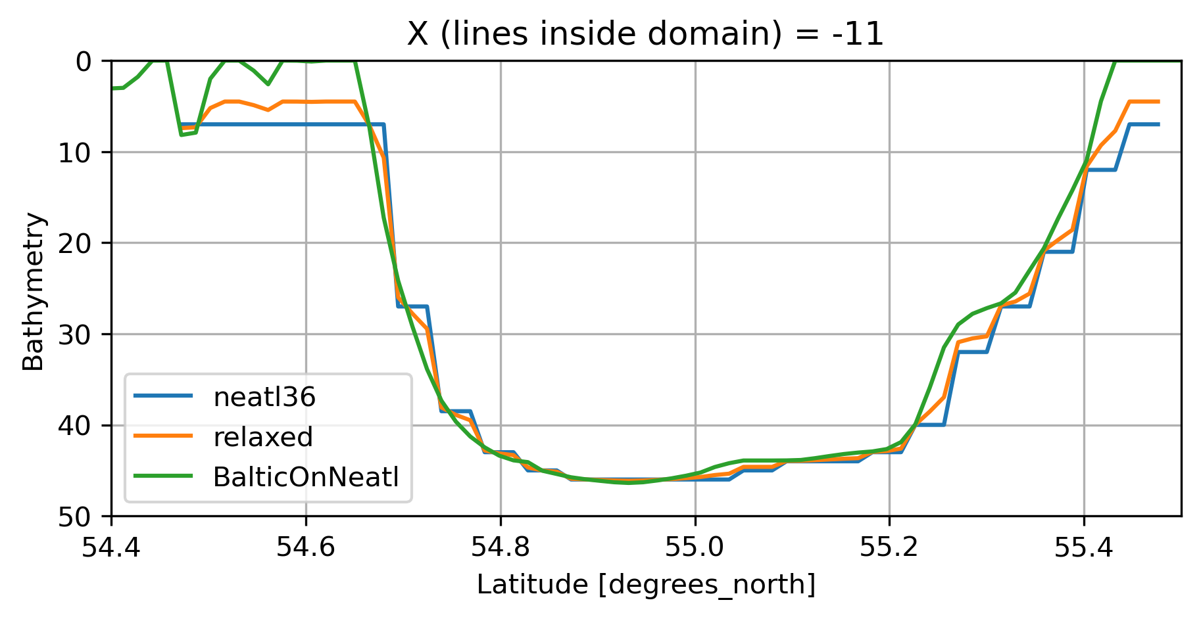
Bathymetry Relaxation

Slide 8
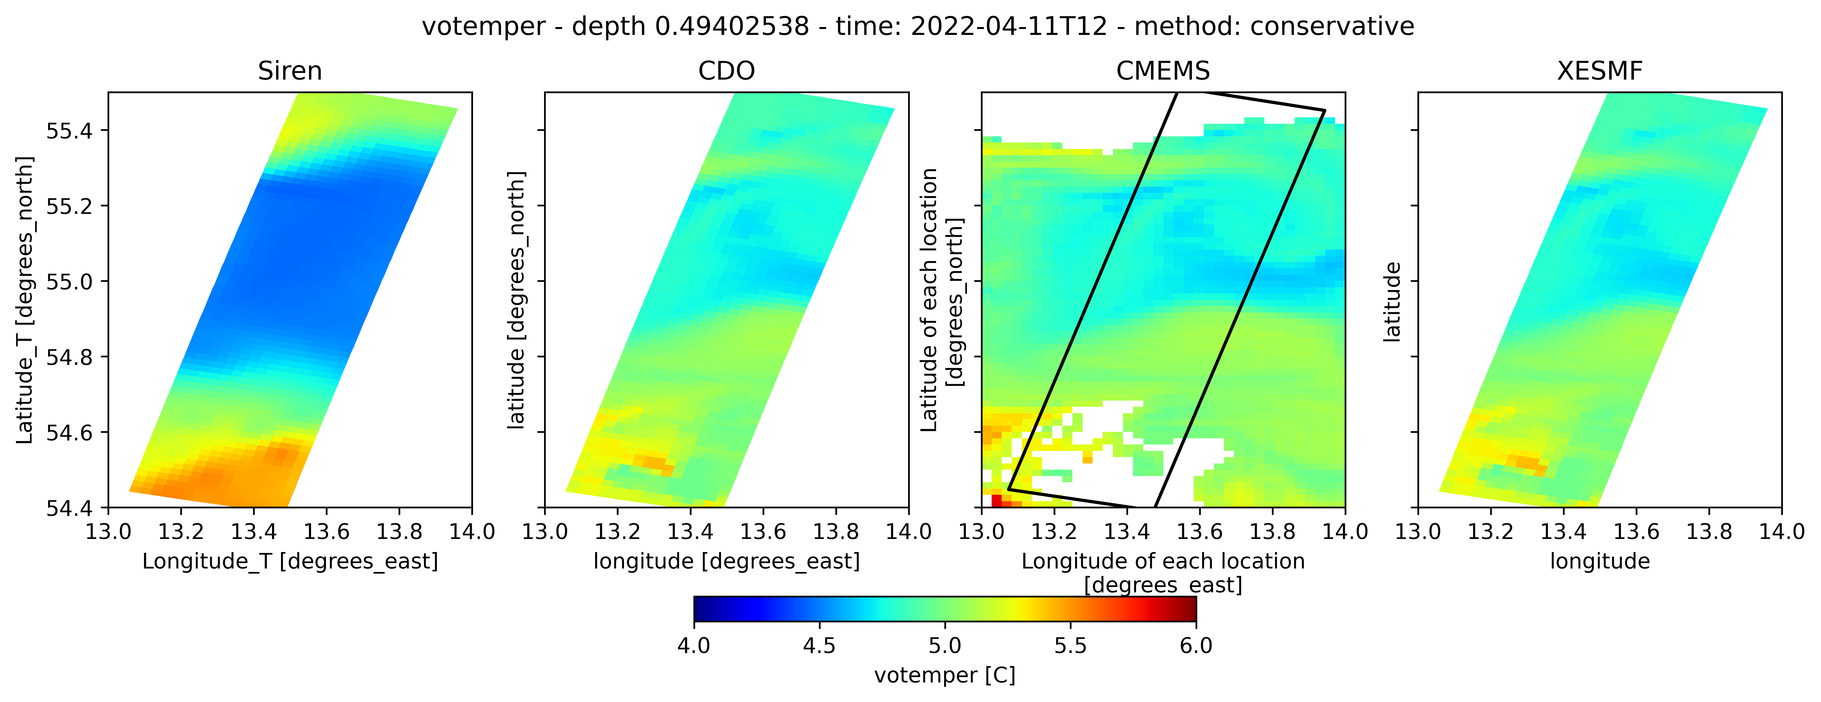
Plots
Maps

Slide 9
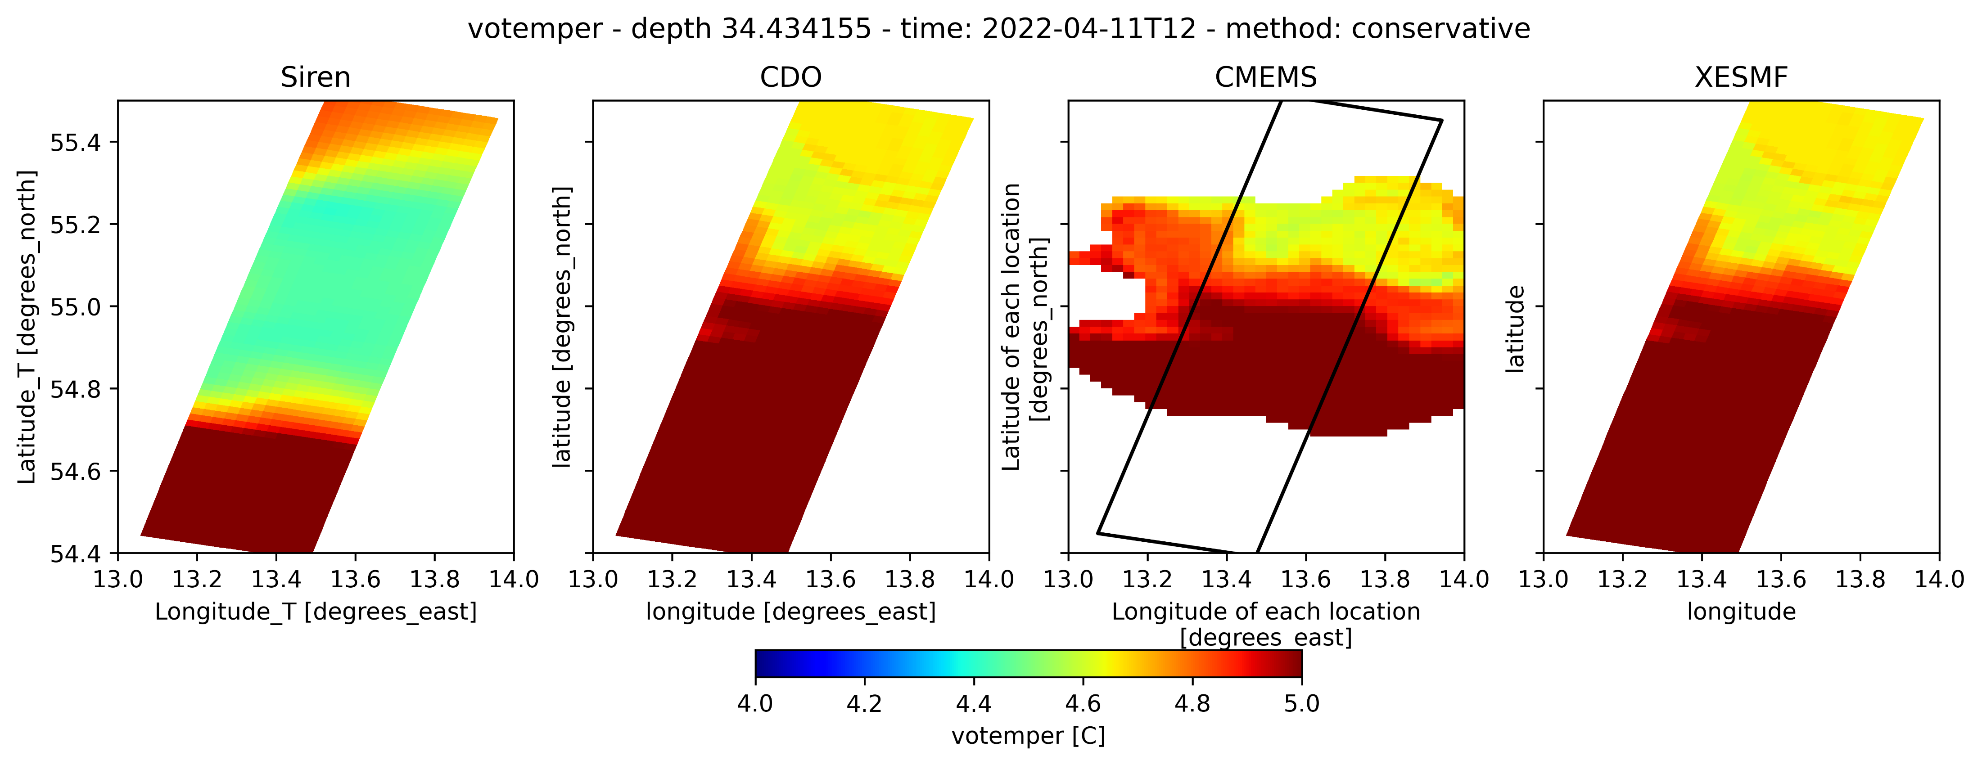
Plots
Maps

Slide 10
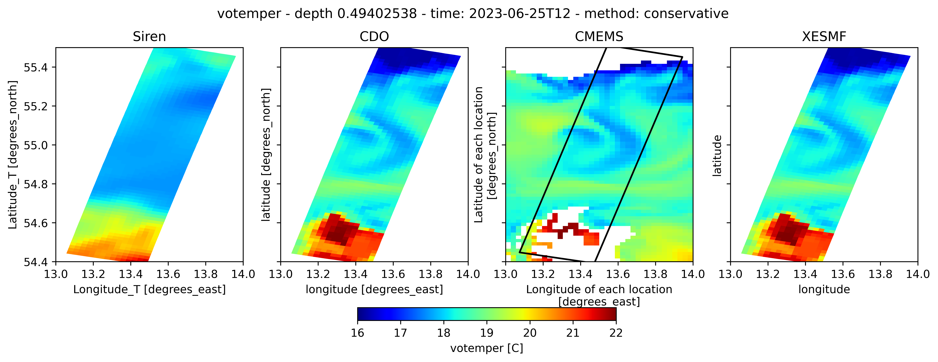
Plots
Maps

Slide 11
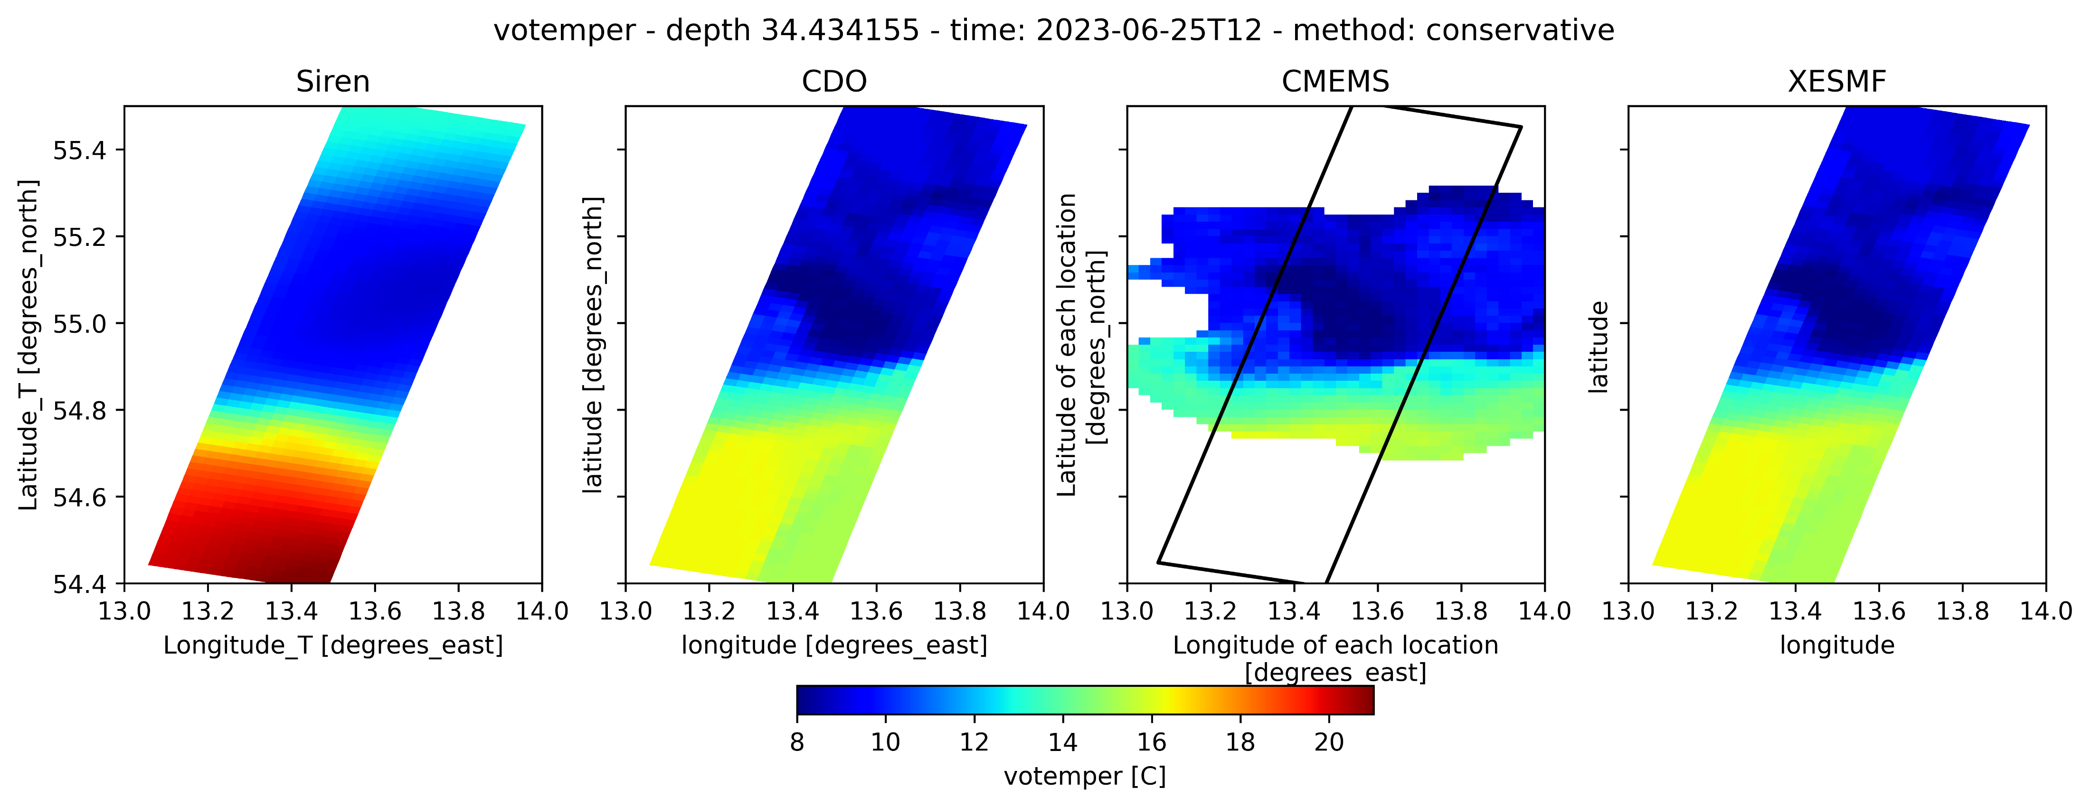
Plots
Maps

Slide 12
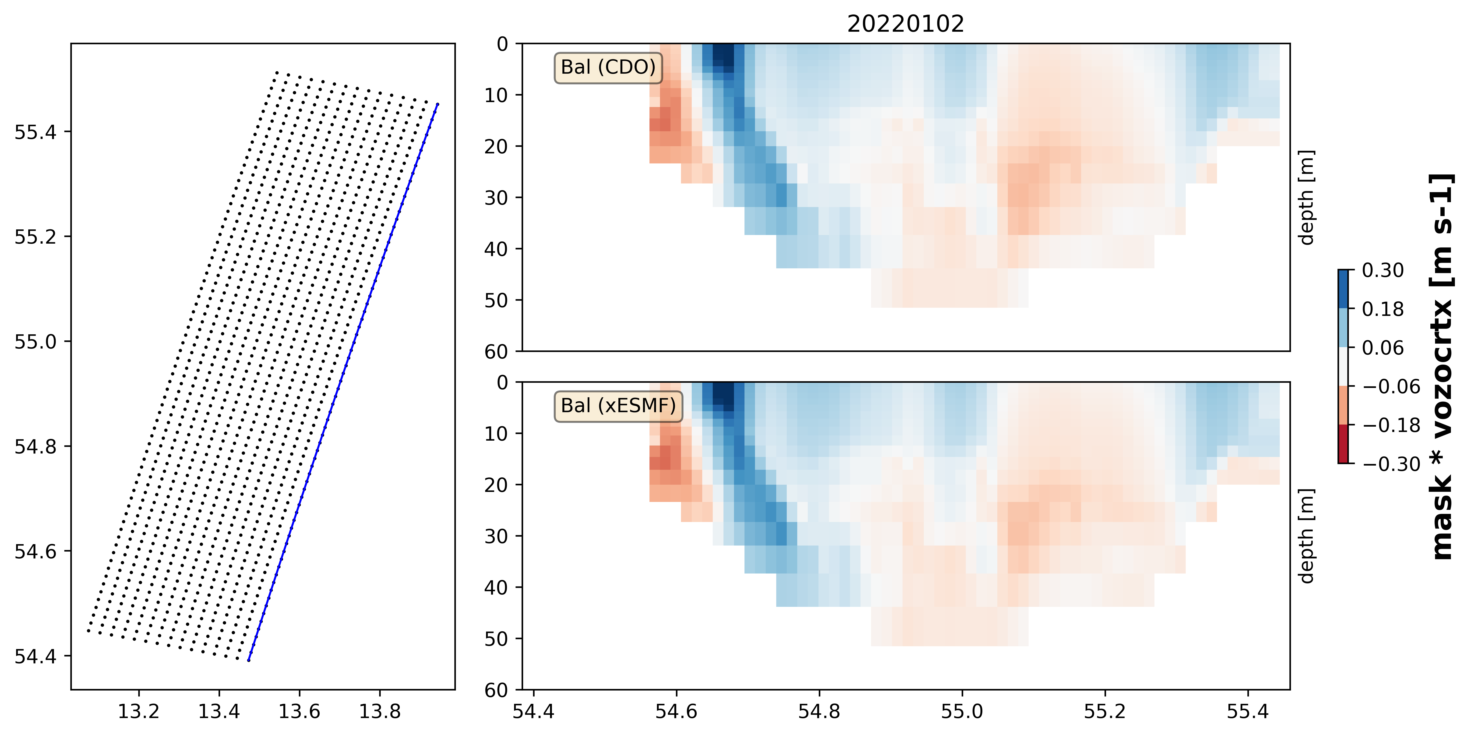
Plots
Transects

Slide 13
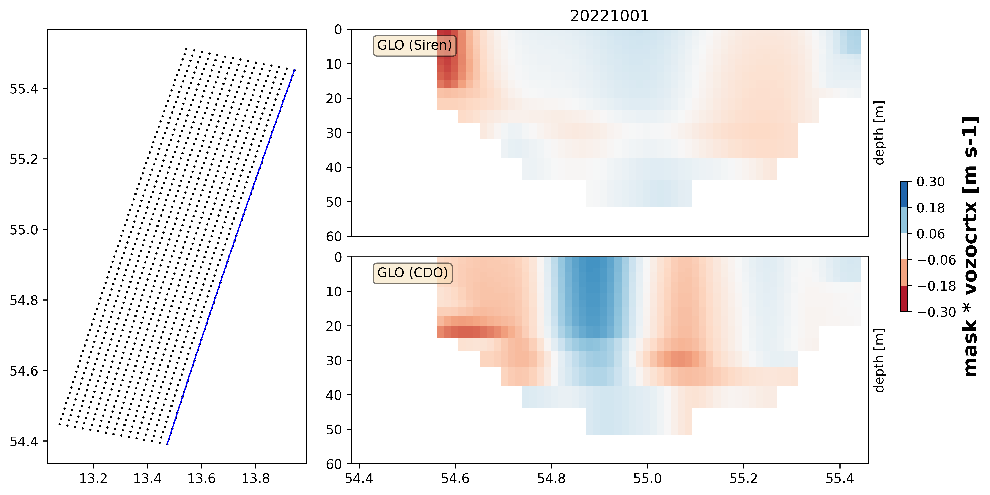
Plots
Transects
WHY SO MUCH DIFFERENCE??

Slide 14
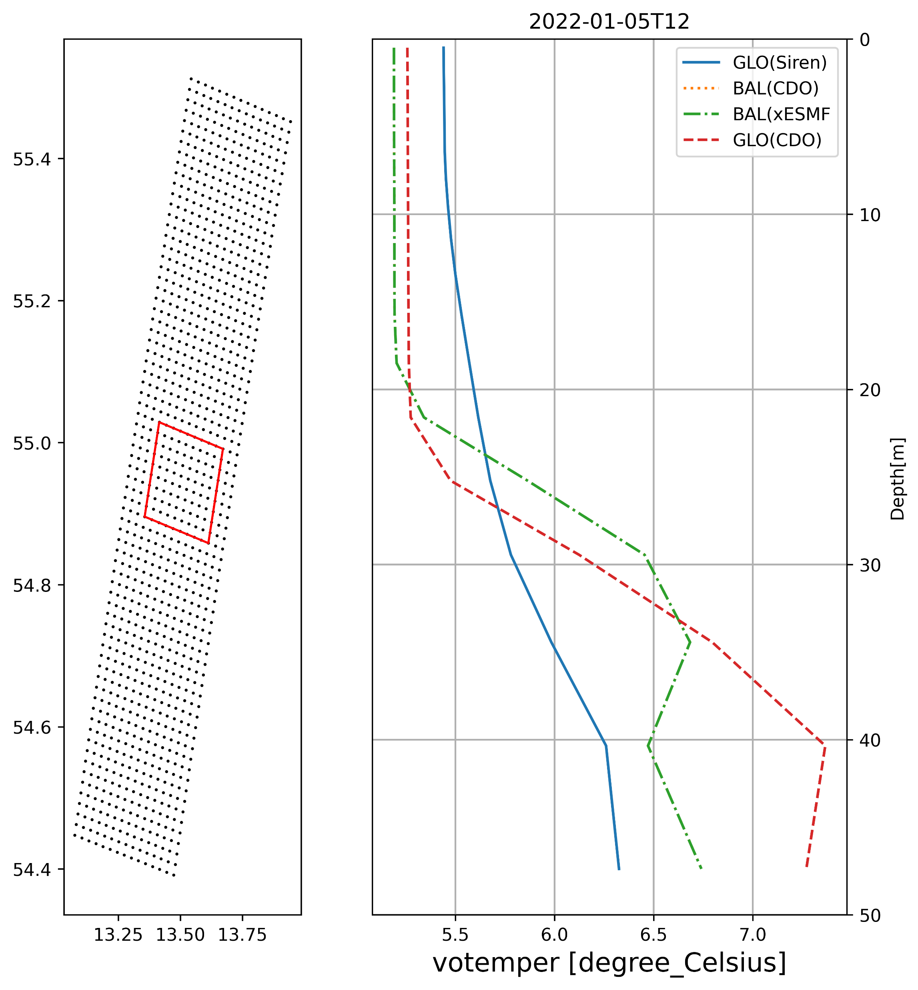
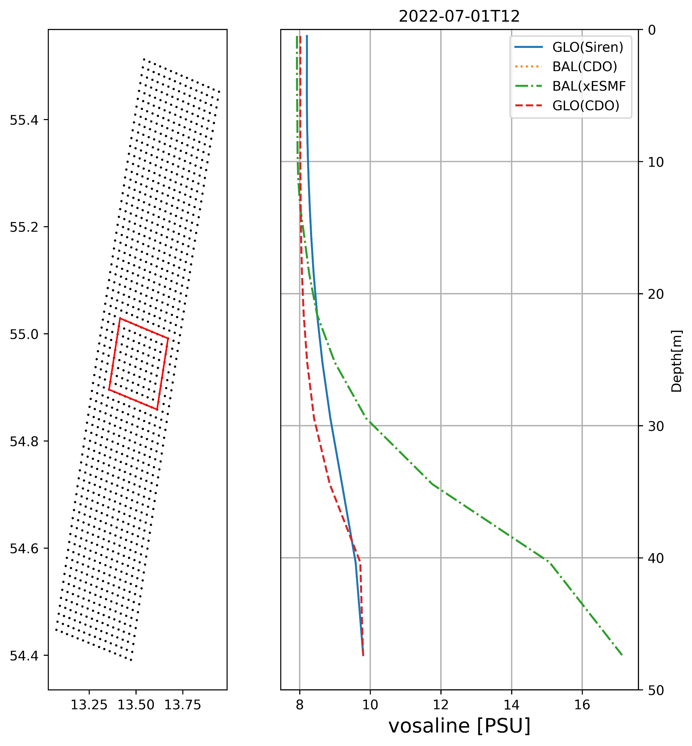
Plots
Box Averaged Profiles

Slide 15
Plots
Timeseries

Slide 16
Plots
Timeseries

Slide 17
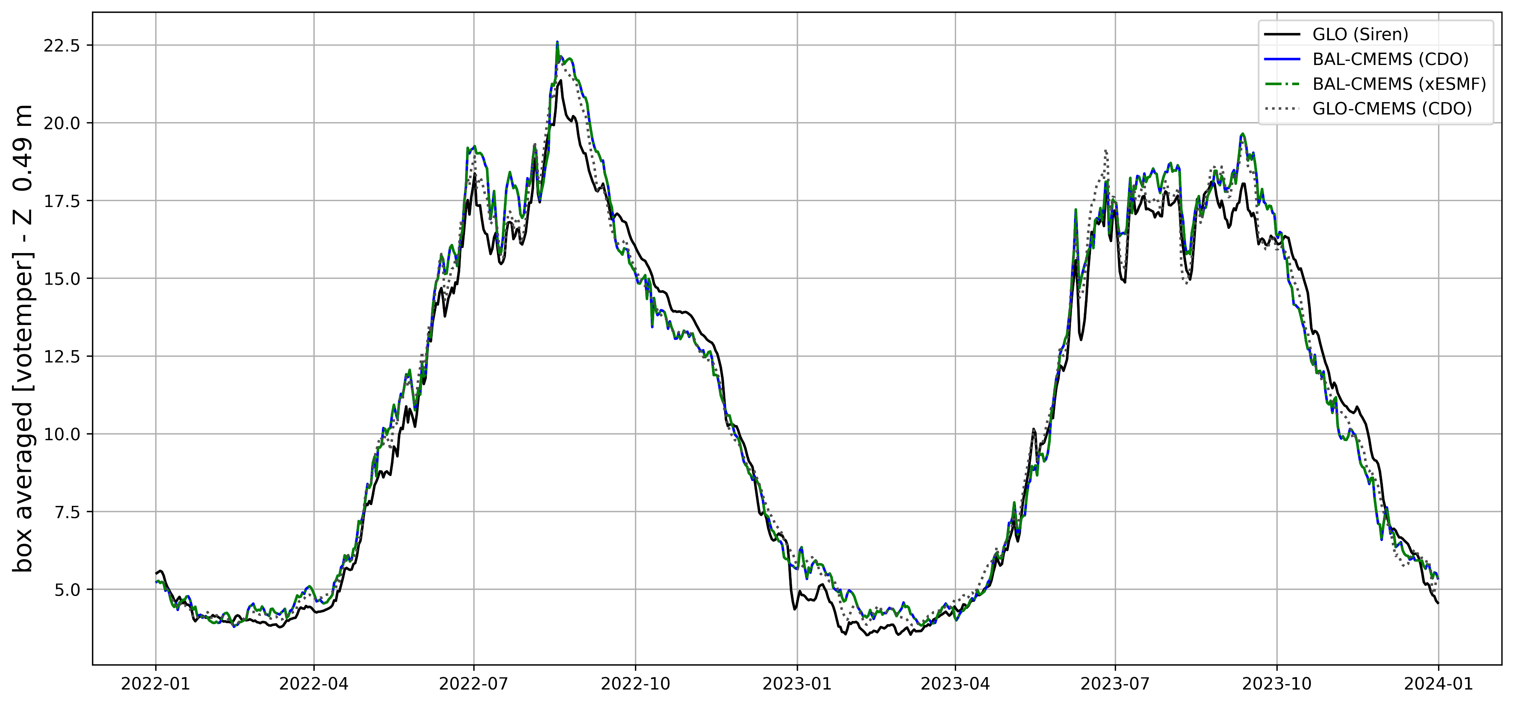
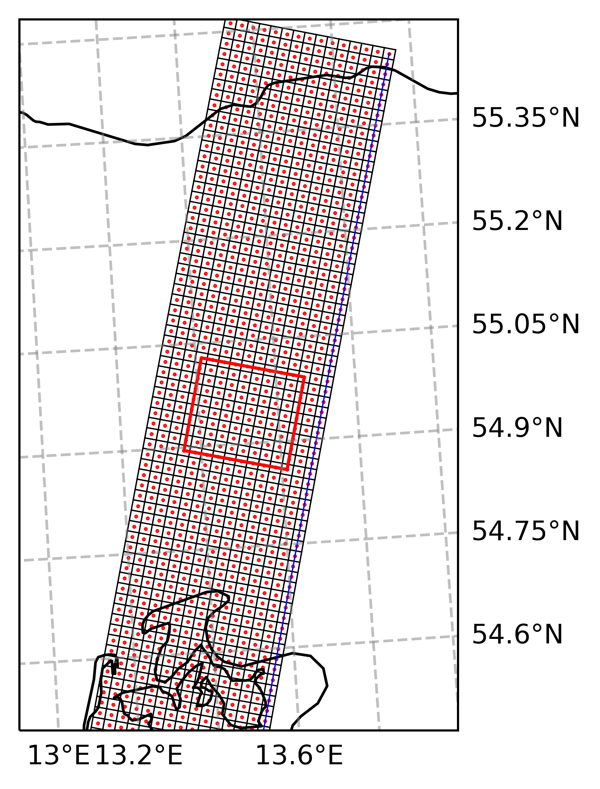
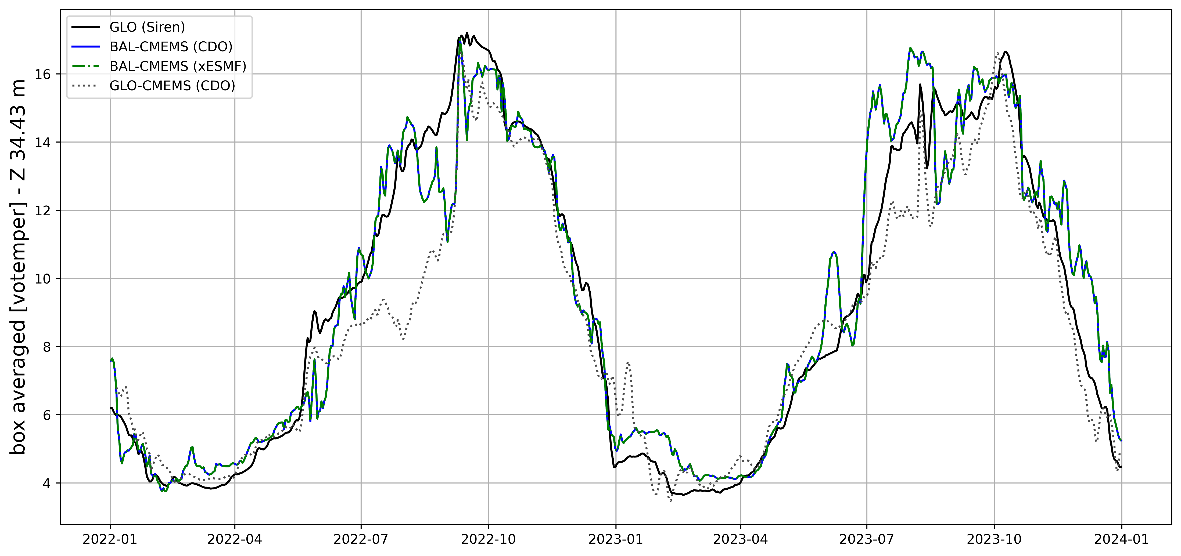
Plots
Timeseries

Slide 18
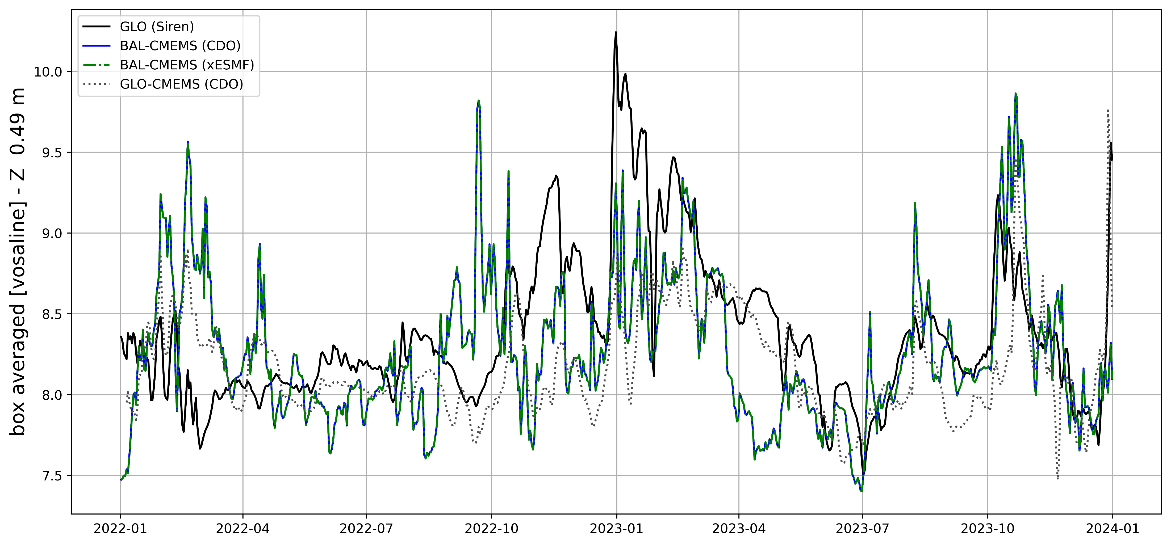
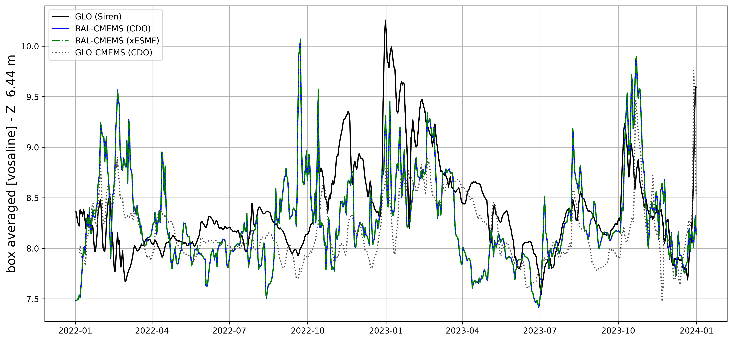
Plots
Timeseries

Slide 19
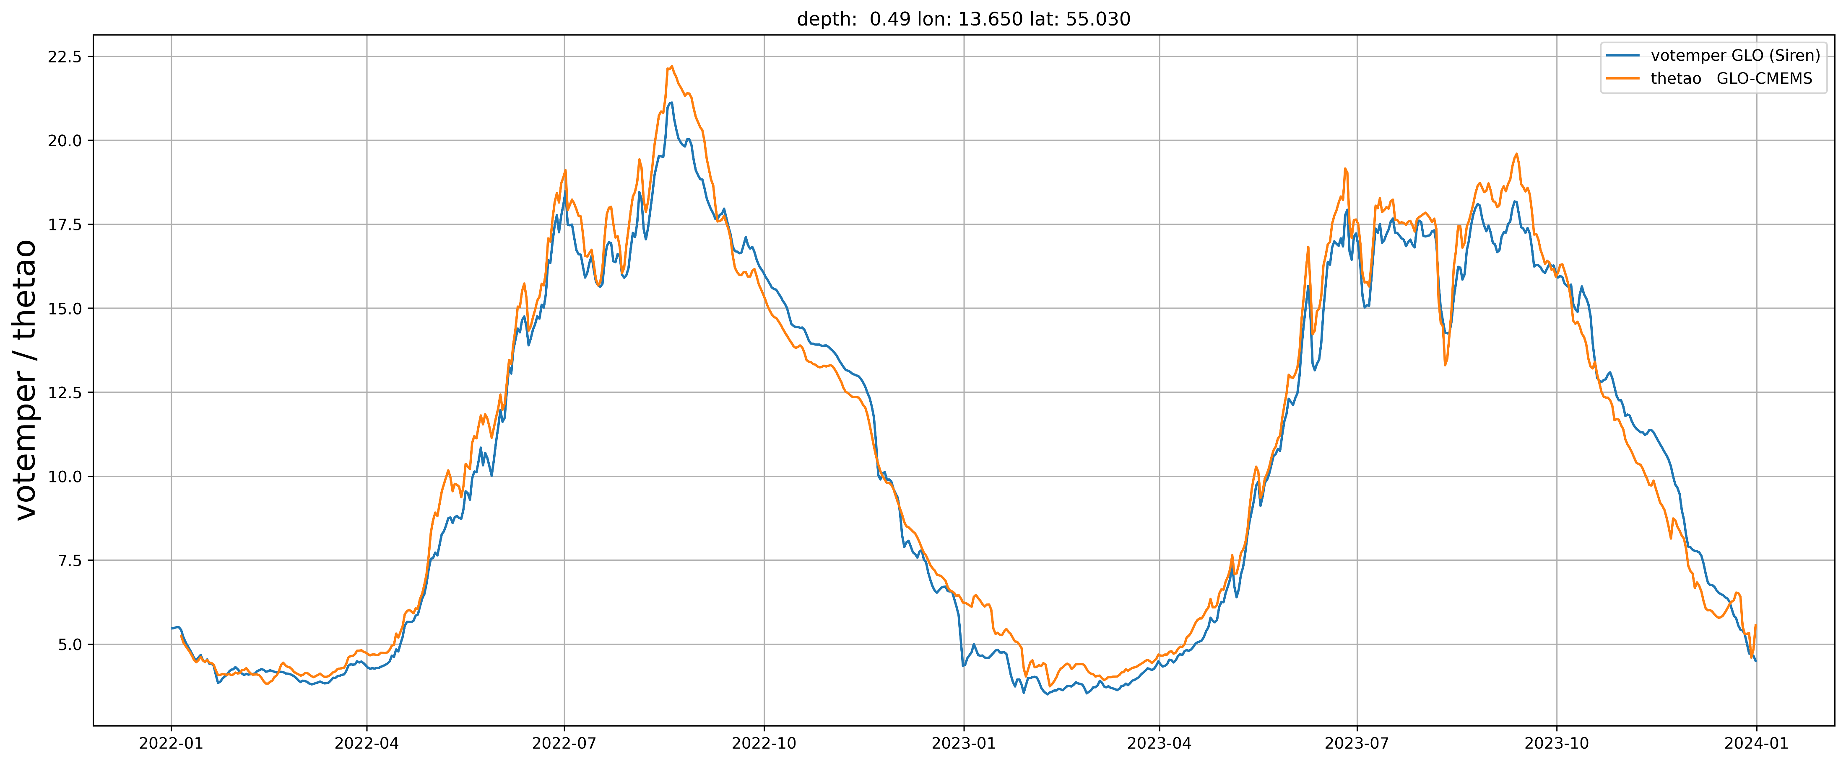
Comparison Siren / CMEMS GLO anfc

Slide 20
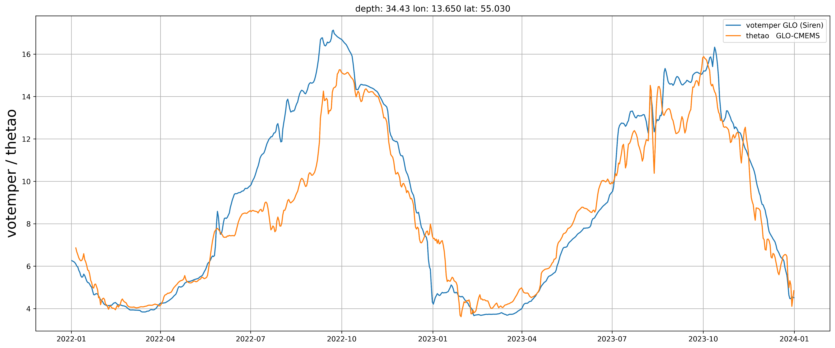
Comparison Siren / CMEMS GLO anfc

Slide 21
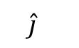
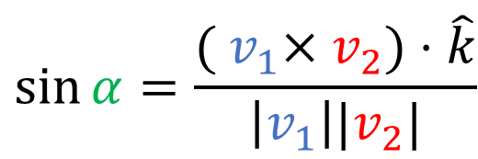
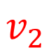
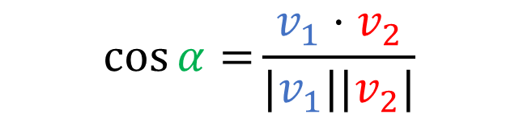

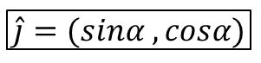
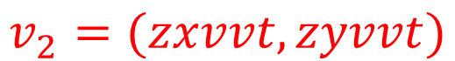
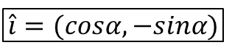

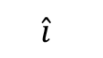
NP
Vectors in stereographic projection
$$v_{1}$$
$$v_{1}=(zxnpt,zynpt)$$
Vector pointing to North Pole
$$v_{2}=(zxvvt,zyvvt)$$
Vector connecting V points in T cell
V
$$\hat{j}$$
α
$$\cos{α=}\frac{v_{1}⋅v_{2}}{|v_{1}||v_{2}|}$$
$$v_{2}$$
T
$$\sin{α=\frac{{( v}_{1}×v_{2})⋅\hat{k}}{\left|v_{1}\right||v_{2}|}}$$
V
$$\hat{i}$$
$$\hat{i}=(cosα,−sinα)$$
$$\hat{j}=(sinα ,cosα)$$

Slide 22
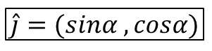
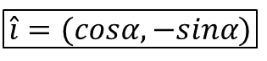
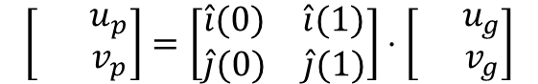
NP
Projection of Velocity from geographical to NEMO (i,j)
$$v_{1}$$
V
$$\hat{i}=(cosα,−sinα)$$
$$\hat{j}$$
α
$$\hat{j}=(sinα ,cosα)$$
$$v_{2}$$
$$\left[\begin{matrix} & u_{p} \\ & v_{p}\end{matrix}\right]=\left[\begin{matrix}\hat{i}(0) & \hat{i}(1) \\ \hat{j}(0) & \hat{j}(1)\end{matrix}\right]⋅\left[\begin{matrix} & u_{g} \\ & v_{g}\end{matrix}\right]$$
T
V
$$\hat{i}$$

